Slide 1


Unit 1
The HHFA data analysis platform
Notes:
Welcome to Unit 1 of Module 2.
This unit will briefly introduce the HHFA data analysis platform.

Slide 2
By the end of this unit, you will:
describe the HHFA data analysis platform
explain country configuration and adaptation of the platform
Notes:
By the end of this unit, you will:
describe the HHFA data analysis platform; and
briefly explain country configuration and adaptation of the platform.

Slide 3



Phase C: Data processing and analysis
data collection
complete
data cleaned in CSPro
data analysis platform
Notes:
Once HHFA data collection is complete, the data are checked and cleaned in CSPro.
The final, clean data set is then exported from CSPro and uploaded to the HHFA data analysis platform.

Slide 4
Phase C: Data processing and analysis
data analysis platform
An online software application built for analysis of HHFA data.
Notes:
The HHFA data analysis platform is an online software application that was specifically built for analysis of HHFA data.

Slide 5
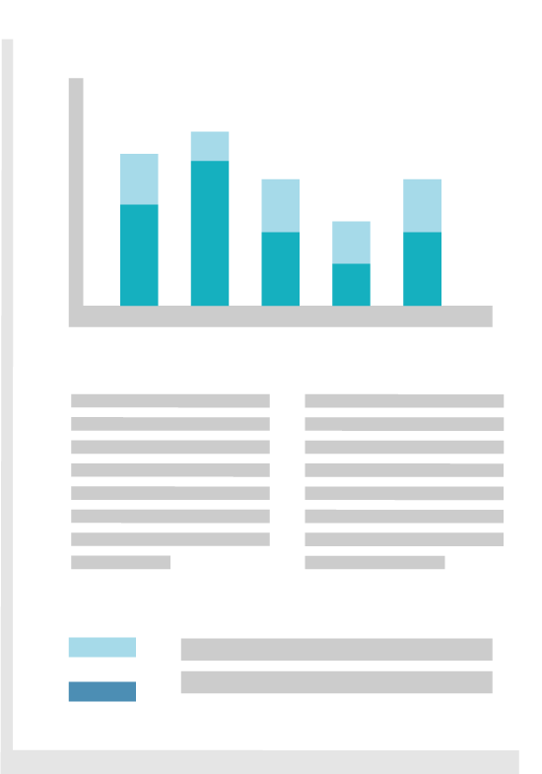
Phase C: Data processing and analysis
data collection complete
data cleaned in CSPro
data analysis platform
standard analysis outputs
A country can also export HHFA data to other statistical software, e.g. Stata/SPSS.
Notes:
The platform automatically calculates the HHFA indicators and displays them in standard tables and graphs - the standard analysis platform outputs.
However, a country can also choose to conduct the analysis by exporting their HHFA data to any other statistical software, such as Stata or SPSS.

Slide 6

Phase C: Data processing and analysis
The data analysis platform organises tables/graphs into a standard report outline, that can:
be generated in Word
serve as a template for the country HHFA report
Notes:
The data analysis platform organizes the standard tables and graphs into a standard report outline that can be generated in Word and can serve as a template for the country HHFA report.

Slide 7
Using the HHFA data analysis platform
Before uploading the final data set to the platform, the country team:
creates a country-specific analysis version (or “instance”) in the data analysis platform
decides who will have access to their country HHFA instance
Notes:
Before uploading the final data set to the platform, the country team must create a country-specific analysis version (or “instance”) in the data analysis platform.
The country team decides who will have access to their country HHFA instance.

Slide 8

Using the HHFA data analysis platform
Country configuration includes:
inserting the survey name and date
inserting the facility identifying information
selecting the modules and questionnaires implemented by the country
selecting the stratifier variables for the analysis
Notes:
Next, the platform must be configured specifically for the country.
Country configuration includes:
inserting the survey name and date;
inserting the facility identifying information;
selecting the modules and questionnaires implemented by the country; and
selecting the stratifier variables for the analysis.
Stratifier variables will be explained later in this module.

Slide 9

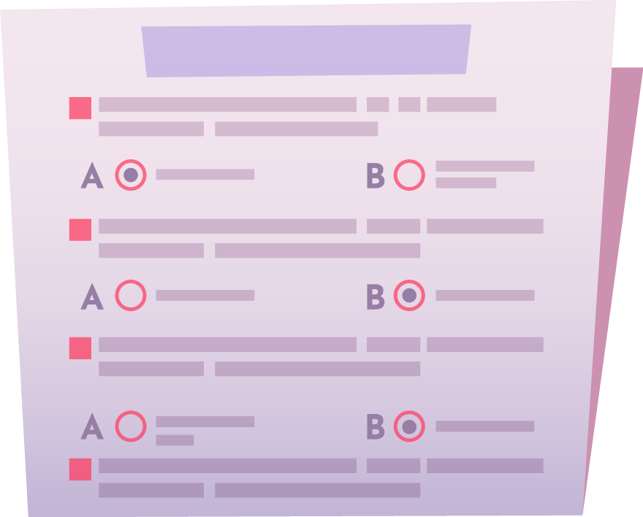
Using the HHFA data analysis platform
countries can adapt outputs (e.g. removing indicators)
additional indicators and tables
country-specific changes to questionnaire
Notes:
When using the platform, countries can adapt the standard analysis outputs to their needs. For example, by removing indicators that they do not require.
They can also create additional indicators and tables based on country-specific changes to the questionnaire.

Slide 10


Using the HHFA data analysis platform
HHFA Comprehensive guide
HHFA Data analysis platform
OpenWHO course
Notes:
Details about how to adapt and use the data analysis platform can be found in the HHFA Comprehensive guide and in the HHFA Data analysis platform OpenWHO course.

Slide 11
You have now completed Unit 1.
In the next unit, we will look at the outputs of the HHFA data analysis platform.
Notes:
You have now completed Unit 1.
In the next unit, we will look at the outputs of the HHFA data analysis platform.

